Slide 1
Unit 4
Environmental pollution
Lecture 17
(Nuclear hazards and human health risks, Radiation Pollution)
1

Slide 2
Learning outcomes
After completing this lecture, you will be able to understand the following:
Student get knowledge about radiation pollution and their effects.
Student understand the basics about Nuclear Hazards and their effect on Human and environment
2

Slide 3
Radiation Pollution
3

Slide 4
Radiation Pollution
Radiation pollution is the emission of any form of ionizing or non-ionizing radiation as a result of natural or human activities.
Causes of Radiation Pollution
Radioactive waste from nuclear power plants.
Nuclear explosions: Release of alpha, Beta and gamma radiations after explosion near testing sites.
Medical use: During diagnosis and treatment of different diseases such as cancer
Radiations from luminous watches, clock dials,
X-rays from microwave, etc.
4

Slide 5
Effects of Radiation Pollution
Somatic Effects: Somatic effects are those which occur in the exposed individual.
Ex-Radiations can cause skin cancer, bone cancer, reduction of life span, premature ageing, cardiovascular disorders, etc.
Genetic Effects- Change in DNA:
Genetic effects may affect subsequent unexposed generations
Ex-Increase in the number of abnormal children and increased
infant mortality.
5

Slide 6
Control of Radiation Pollution
Dense trees should be planted around atomic power plants.
Proper management of radioactive waste should be ensured.
Unnecessary X-ray examination should be avoided. Lead shields should be used by workers.
During nuclear installations, various efforts including the process of site selection, its design, construction, operation, and its short-term and long-term effects should be seriously considered to control radiation.
https://www.youtube.com/watch?v=p0ezr7Zug2s
6

Slide 7
Nuclear Accidents and Holocaust
7

Slide 8
Nuclear Accidents
In nuclear reactor/power plants/testing sites etc.- Due to natural and man made activities, a situation in which an uncontrollable chain reaction arises and responsible for loss of property and life on large scale is referred as nuclear accidents.
https://www.youtube.com/watch?v=R-_lGthFm1M
8

Slide 9
Causes of Nuclear Accidents
Natural Disasters: Fukushima Daiichi Nuclear Accident as caused due to Tsunami and earthquake.
Improper following of procedures: The controlled nuclear reaction can be achieved only by following set of procedures. Chernobyl disaster.
Faulty infrastructure of reactor: This can cause leakage of radioactive material.
Malfunctioning of the system: The coolant system is affected.
9

Slide 10
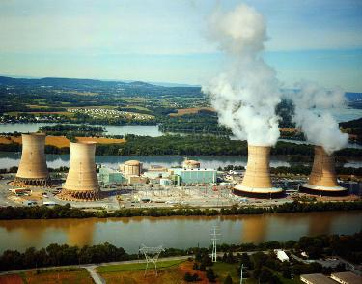
Examples of Nuclear Accidents
Three Mile Island Disaster
On March 28, 1979, Reactor #2 at the Three Mile Island (TMI), USA. Fuel rods were damaged, leaking radioactive material.
Consequences
40,000 gallons of radioactive waste water directly in the river.
Total cleanup cost of $1 billion.
140,000 pregnant women and pre-school age children from the area.
https://www.youtube.com/watch?v=sVTHeRbWRi4
10

Slide 11
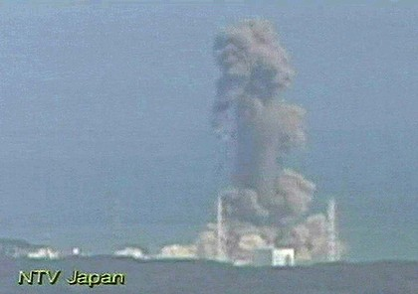
Examples of Nuclear Accidents
Fukushima Daiichi Nuclear Disaster
Releases of radioactive materials at the Fukushima I Nuclear Power Plant, following the Tōhoku earthquake and tsunami on 11 March 2011.
https://www.youtube.com/watch?v=UfS53M-KqwY
11

Slide 12
Effects of Nuclear Accidents
Biological Effects
Thyroid cancer : Caused due to radioactive Iodine which is a common radioactive material used in reactors.
Loss of white blood cells and platelets : Which impairs immune system and may cause hemorrhaging.
Leukemia : Skin cancer caused due to exposure of gamma rays.
Bioaccumulation: Of radioactive material in food chain.
Genetic Mutation: Causes changes in DNA sequence.
12

Slide 13
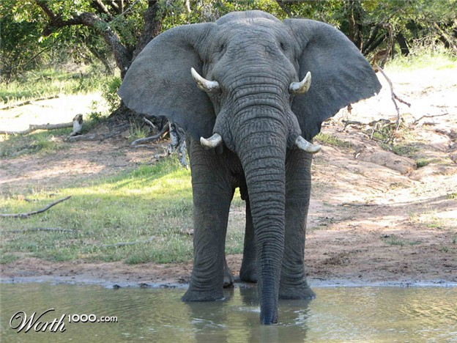
Effects of Nuclear Accidents
Genetic Mutation
13

Slide 14
Effects of Nuclear Accidents
Non Biological effects
Loss of Infrastructure: Destruction of buildings, bridges etc.
Cost of cleanup : Total cleanup cost for Three Mile island disaster was $1 billion
Explosions: Causes mass destruction of human lives and other life forms.
Evacuations: Immediate evacuation of people in affected areas
14

Slide 15
Effects of Nuclear Accidents
Harm to Ozone layer: The explosions causes nitrogen oxides to form from the oxygen and nitrogen in the atmosphere which depletes ozone layer.
Nuclear Winters: The absorption of sunlight when large amounts of soot are injected into the atmosphere
15

Slide 16
Prevention of Nuclear Accidents
Proper Disposal of radioactive wastes: Reactor wastes can be dumped in deep unused mines
Awareness among public.
Proper transportation: The transporting containers must be leakage proof.
Making the violation of procedures a criminal offense
Ban on nuclear weapons
Strong infrastructure and proper maintenance.
16

Slide 17
Nuclear Disaster and Holocaust
Holocaust
The great destruction of life forms at the mass level causing genocide, that is complete destruction of a human civilization.
Nuclear Holocaust
The possibility of complete life destruction on earth due to nuclear weapons.
17

Slide 18
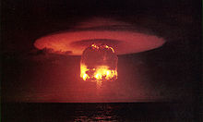
18

Slide 19
Nuclear Disaster and Holocaust
“Nuclear physicists and authors have speculated end of human life or at least modern civilization due to nuclear war fares”
19

Slide 20
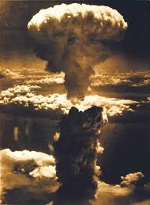
Real Life Events of Holocaust
Hiroshima and Nagasaki Bombing
During the World War 2 USA Conducted 2 atomic bombs against Cities of Japan, Hiroshima and Nagasaki.
Hiroshima: August 6, 1945
Death Toll: 90,000–166,000 people
Nagasaki: August 9, 1945
Death Toll: 60,000–80,000
20

Slide 21
Important Video and Web Link
http://www.creationconcepts.org/resources/NUCLEAR.pdf
https://www.fs-ev.org/fileadmin/user_upload/89_News/Oeff.-Arbeit/Radiation_Effects_and_sources-2016.pdf
https://www.ugc.ac.in/oldpdf/modelcurriculum/Chapter5.pdf
https://www-pub.iaea.org/MTCD/publications/PDF/Pub913e_web.pdf
21

Slide 22
Acknowledgment
Some images, animation, and material have been taken from the following sources:
Text Books: PERSPECTIVE IN ENVIRONMENTAL STUDIES by ANUBHA KAUSHIK, C P KAUSHIK, NEW AGE INTERNATIONAL PUBLISHERS
References Book: TEXT BOOK OF ENVIRONMENTAL STUDIES by D. DAVE AND S. S. KATEWA, CENGAGE LEARNING
3 All slides can be used for reading purpose only
22

